Slide 1
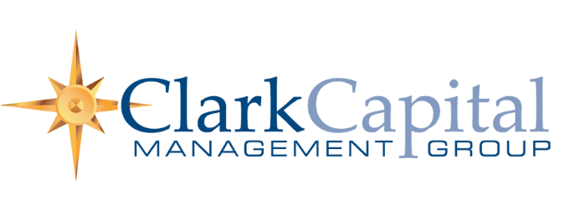
Q2 2023 Review & Outlook
Glenn Dorsey, CFA®, CAIA®

Slide 2
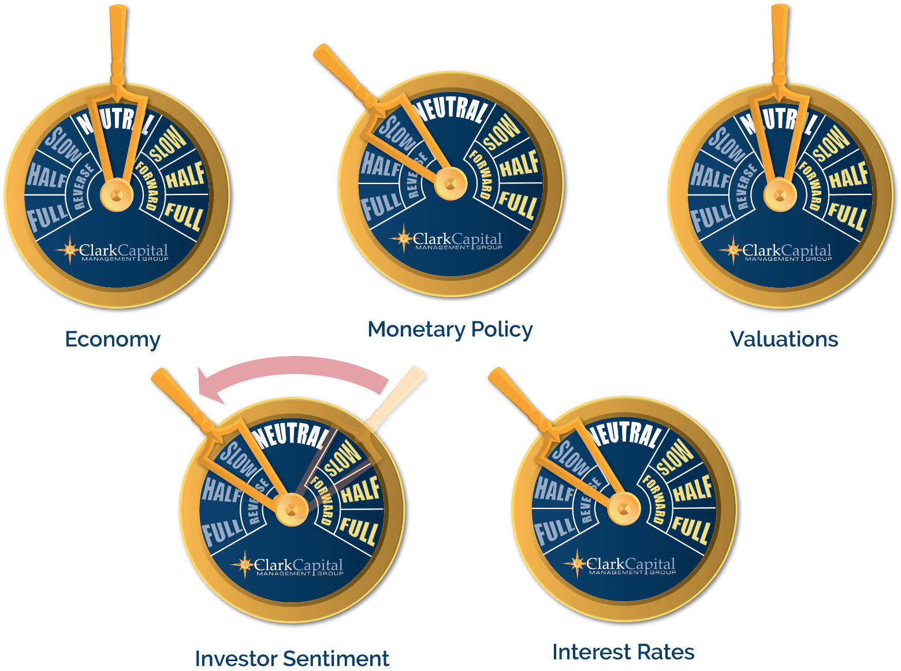
Economic Gauges
The gauges reflect the degree of Clark Capital’s positive (forward) or negative (reverse) outlook on the corresponding economic factors. The gauges represent the firm's expectations for the market, and how changes in the market will affect the strategy but are only projections which assume certain economic conditions and industry developments and are subject to change without notice.
Notes:
As a reminder, these gauges represent the 5 major areas that help shape our view for the overall economic environment, which in turn drives our expectations for the stock market. Recall 12:00 is neutral, anything to the right of 12:00 is positive for stocks, anything to the left of 12:00 is negative. We made adjustments to three gauges this quarter and I will discuss those shortly.
(Economic Expansion Length Slide)
Our first gauge is the U.S. economy, which we leave in a slow forward position.
The first half of 2019 grew around 2.6% and the final reading of 3rd quarter GDP came in at 2.1% with 4th quarter growth estimates trending at a similar pace. Economic growth in 2019 was not as strong as 2018, but back to trend growth in the low 2% range, which we have experienced for most of the post-credit crisis period.
As we move into 2020, we expect economic growth to continue at a similar pace well into the New Year. While a few warnings signs of slower growth developed in 2019, we believe most indicators we monitor show little threat of a slowdown occurring in the near-term.
(Job slide…either claims, payroll or U6)
In particular, job market data remained strong throughout 2019. Almost 70% of our economy is driven by consumer spending, so an employed and financially healthy consumer is a key driver of economic growth. The unemployment rate and jobless claims hover near 50-year lows and job additions have been positive throughout the year. We believe the job market remains healthy as we move into 2020.
(LEI Slide)
The Conference Board’s Leading Economic Indicators Index (the red line on the bottom of this chart), was a bit mixed later in the year after putting in record highs multiple times in 2019.
Historically, this indicator peaks about 11 months prior to a recession and in the last 3 recessions, that lead time has been longer at 16 months. It is too early to determine if this index has hit a cycle high, but regardless, we believe it is not indicating any sort of imminent recession as we move into the New Year.
(ISM Manufacturing & Non-Manufacturing PMIs)
Manufacturing has been a point of weakness in the U.S. for the last few months. The ISM Manufacturing Index recorded a reading in August below 50, the demarcation line between expansion and contraction and it has stayed below 50 for four consecutive months. Manufacturing is directly impacted by the headwinds of higher tariffs and the uncertainty of U.S. and China trade negotiations. On a positive note, a phase one trade deal with China appeared to be reached late in the year and this could provide some near-term relief to the manufacturing sector. Furthermore, the ISM Non-Manufacturing Index, which covers the much larger service industries in the U.S. economy, has remained comfortably above the 50 level in recent years.
(Yield Curve 10s/2s & 10s/3mos)
Finally, the yield curve inverted in 2019, historically a sign of upcoming economic headwinds. As a reminder, the prior seven recessions dating back to 1962, have all been preceded by an inverted yield curve, but we have had two instances of an inverted yield curve without a subsequent recession. The inversion is often induced by a Fed that tightens rates too much.
An important question we ponder as we move into 2020 is whether the Fed’s quick and rather dramatic reversal of policy from 2018 to 2019 was enough to curtail the potential damage done by higher front-end rates. Were the three rate cuts in 2019 enough to rekindle growth and avert a near-term recession?
While history does not favor the Fed’s ability to engineer this type of soft landing and recovery, it is yet to be seen whether they pulled it off this time. Initially, the economy has continued to grow and some better momentum surfaced in the latter part of the year, so that is an encouraging sign.
All in all, we believe the fundamental backdrop for the economy continues to look solid and we expect growth to continue well into 2020. In other words, we do not see a recession on the horizon through at least 2020. The Federal Reserve does not have a recession in its forecast through 2022.
(Cycle back to Gauge Slide)
This leads us to Monetary Policy, which we bring back to a Neutral position moving into 2020. The Fed went from four rate hikes in 2018 to dovish comments in early 2019, which ultimately led to three rate cuts in the second half of last year. The Fed indicated it would likely be on hold from some time after that third cut and the bar appears to be very high for any Fed action in 2020, so we therefore move this gauge back to Neutral.
(Fed Funds Slide)
We have been in a period in recent years where actions by the Fed were often pivotal for economic and capital market expectations. We might be entering a period when the Fed could largely be on the sidelines and issues like the robustness of economic growth, ongoing trade negotiations with China, company earnings and, yes, a presidential election might be more front and center.
Never count out the Fed and the impact it might have on the economy and markets, but 2020 might be a year when the Fed moves back to its historical role of operating monetary policy in the background of the economy – a respite I’m sure Fed Chairman Powell would welcome.
(Back to Gauges)
Next are valuations, which we move back one notch to a Neutral position.
(P/E slide)
Stocks rose to record highs last year. From a market valuation perspective, the P/E ratio for the S&P 500 moved to around 18x forward operating earnings. Clearly, this was a year when the “P” or prices rose much more rapidly than the “E” or earnings.
This valuation expansion has meant that stocks have become more expensive. While expensive on a historical basis, interest rates remain low from a historical perspective as well, and this combination makes us move the valuation gauge back only one notch to Neutral.
(Earnings Growth Expectations)
Earnings have been on quite a ride over the last two years. Earnings growth was dramatic in 2018 driven in large part by the tax cuts. Those earnings gains created a very tough comparison year in 2019 and earnings were muted. Now the tables have turned once again and comps become easier in 2020 for corporate America.
We do not expect further valuation expansion in 2020, so earnings growth will be an important driver of potential stock market gains this year.
(Back to Gauge Slide)
The next gauge is Investor Sentiment, which can be thought of as a measure of speculation. Recall this gauge is a contrarian indicator based on the behavior of investors and moving into 2020, we drop this gauge two spots from Slow Forward to Slow Reverse.
(NDR Sentiment Indicator)
As the stock market continued to hit new highs throughout December, investor sentiment grew to a point that now looks a bit optimistic, which can be a contrarian signal.
(Fund Flows)
Fund flow data drove our decision to change this indicator to a Slow Forward last quarter and while the one-way fund flow out of stock and into bond mutual funds and ETFs continued late last year, the pace of outflows has slowed. Volatility, which we will discuss shortly, was also largely absent late in the year and this can be a contrarian sign as well.
After reviewing both sentiment and fund flow data, along with suppressed volatility, we are compelled to move the Investor Sentiment indicator back to a Slow Reverse position.
(Back to Gauge Slide)
Our final gauge is interest rates, which we leave in a Neutral position.
(10 Yr and 30 Yr UST slide)
As the Fed became dovish and ended up cutting rates in 2019, interest rates dropped rather dramatically with multi-year and even historic low interest rates put in during August. Lower rates, which lower the cost of capital, are a net positive for an economy generally speaking.
However, the inversion of the yield curve in 2019 is a historically negative warning sign. And although the yield curve is now positively sloped, it is also quite flat, which has typically been a more challenging environment for stocks. With these two countervailing signs present, we keep the Interest Rate gauge in a Neutral position.

Slide 3
Executive Summary
Increasing S&P 500 price target to 4500 from 4200
Labor market continues to fuel economy
The Fed skipped a meeting
We believe valuations are “fair" for stocks
We believe fear is starting to be replaced by greed
Yield curve remains inverted, and long rates have moved down
Notes:
We believe the Long Term Secular Bull Market is still alive. We are looking for about 8% price appreciation for the S&P 500. Earnings growing 8%, no P/E expansion. We expect more volatility this year, especially leading up to the elections. We do not see a recession on the horizon (through this year) although there have been some signs of slowing. Always lots of risks. International stocks could outperform US as valuations are attractive and will benefit if the dollar weakens. We think the Fed is on hold possibly through year end. Of course they are data dependent, but growth looks sustainable and inflation remains in check. We think interest rates are range bound between 1.5% to 2.5%.

Slide 4
Why Did We Keep the Economic Gauge Neutral?
Growth has slowed, but the labor market is holding firm
Inflation continues to come down. Easy comparisons almost behind us
Q2 Y/Y earnings expected to be up double digits on heels of Q1 rebound
Why does this matter? GDP helps drive earnings
Notes:
We believe the Long Term Secular Bull Market is still alive. We are looking for about 8% price appreciation for the S&P 500. Earnings growing 8%, no P/E expansion. We expect more volatility this year, especially leading up to the elections. We do not see a recession on the horizon (through this year) although there have been some signs of slowing. Always lots of risks. International stocks could outperform US as valuations are attractive and will benefit if the dollar weakens. We think the Fed is on hold possibly through year end. Of course they are data dependent, but growth looks sustainable and inflation remains in check. We think interest rates are range bound between 1.5% to 2.5%.

Slide 5
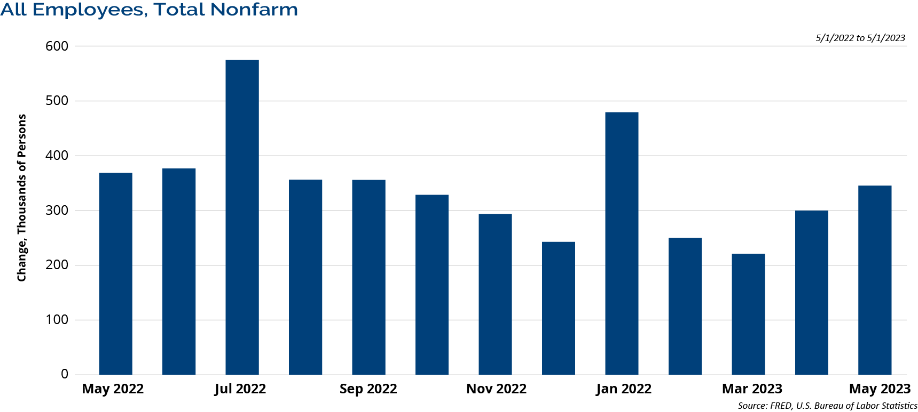
Labor Market Continues to Buoy the Economy
For illustrative purposes only.
Notes:
We look at a lot of data and indicators to gauge the health of the economy. I’d like to share with you several that we put more stock in when assessing the economic outlook. Those are the Conference Board’s Index of Leading Economic Indicators, Housing Starts, the health of the labor market, and the shape of the yield curve. We’ve highlighted all three of those in each of the past several Market Outlooks. Up to this point their message has been continued economic growth.
The Conference Board’s Index of Leading Economic Indicators (the blue line on the bottom of this chart) has softened a bit but does not appear to be signaling a recession yet. This is important because it will typically turn down significantly on average 11 months before a recession. The red line on this chart is the Coincident Economic Index which measure how conditions are currently. Prior to a recession the Leading Index will typically cross below the Coincident Index and this has not happened

Slide 6
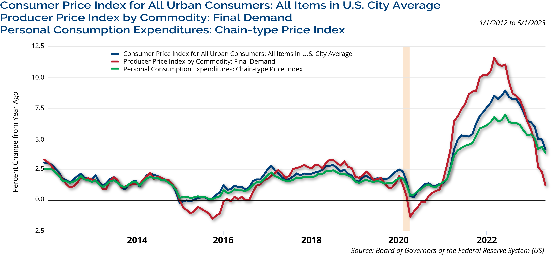
Inflation Continues to Recede from High Seen Last Year
For illustrative purposes only. Past performance is not indicative of future results.
Source: fred.stlouisfed.org
Notes:
We look at a lot of data and indicators to gauge the health of the economy. I’d like to share with you several that we put more stock in when assessing the economic outlook. Those are the Conference Board’s Index of Leading Economic Indicators, Housing Starts, the health of the labor market, and the shape of the yield curve. We’ve highlighted all three of those in each of the past several Market Outlooks. Up to this point their message has been continued economic growth.
The Conference Board’s Index of Leading Economic Indicators (the blue line on the bottom of this chart) has softened a bit but does not appear to be signaling a recession yet. This is important because it will typically turn down significantly on average 11 months before a recession. The red line on this chart is the Coincident Economic Index which measure how conditions are currently. Prior to a recession the Leading Index will typically cross below the Coincident Index and this has not happened

Slide 7
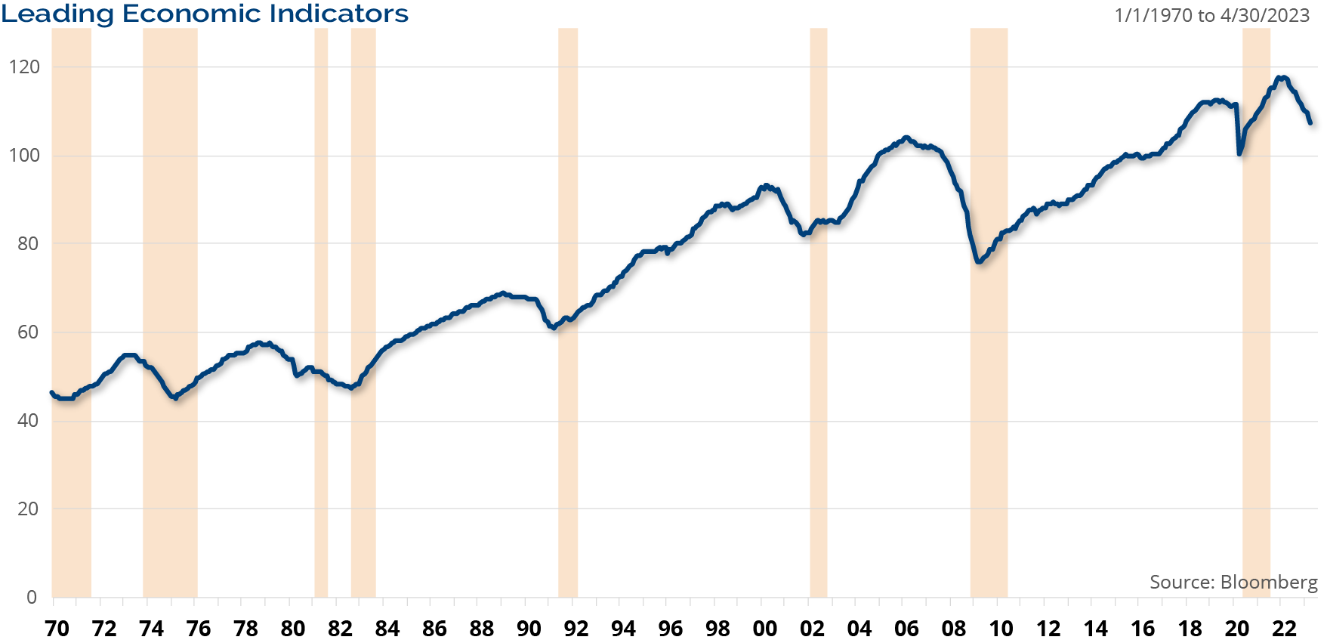
Economy Likely to Slow
For illustrative purposes only. Past performance is not indicative of future results.
Source: Ned Davis Research
Notes:
We look at a lot of data and indicators to gauge the health of the economy. I’d like to share with you several that we put more stock in when assessing the economic outlook. Those are the Conference Board’s Index of Leading Economic Indicators, Housing Starts, the health of the labor market, and the shape of the yield curve. We’ve highlighted all three of those in each of the past several Market Outlooks. Up to this point their message has been continued economic growth.
The Conference Board’s Index of Leading Economic Indicators (the blue line on the bottom of this chart) has softened a bit but does not appear to be signaling a recession yet. This is important because it will typically turn down significantly on average 11 months before a recession. The red line on this chart is the Coincident Economic Index which measure how conditions are currently. Prior to a recession the Leading Index will typically cross below the Coincident Index and this has not happened

Slide 8
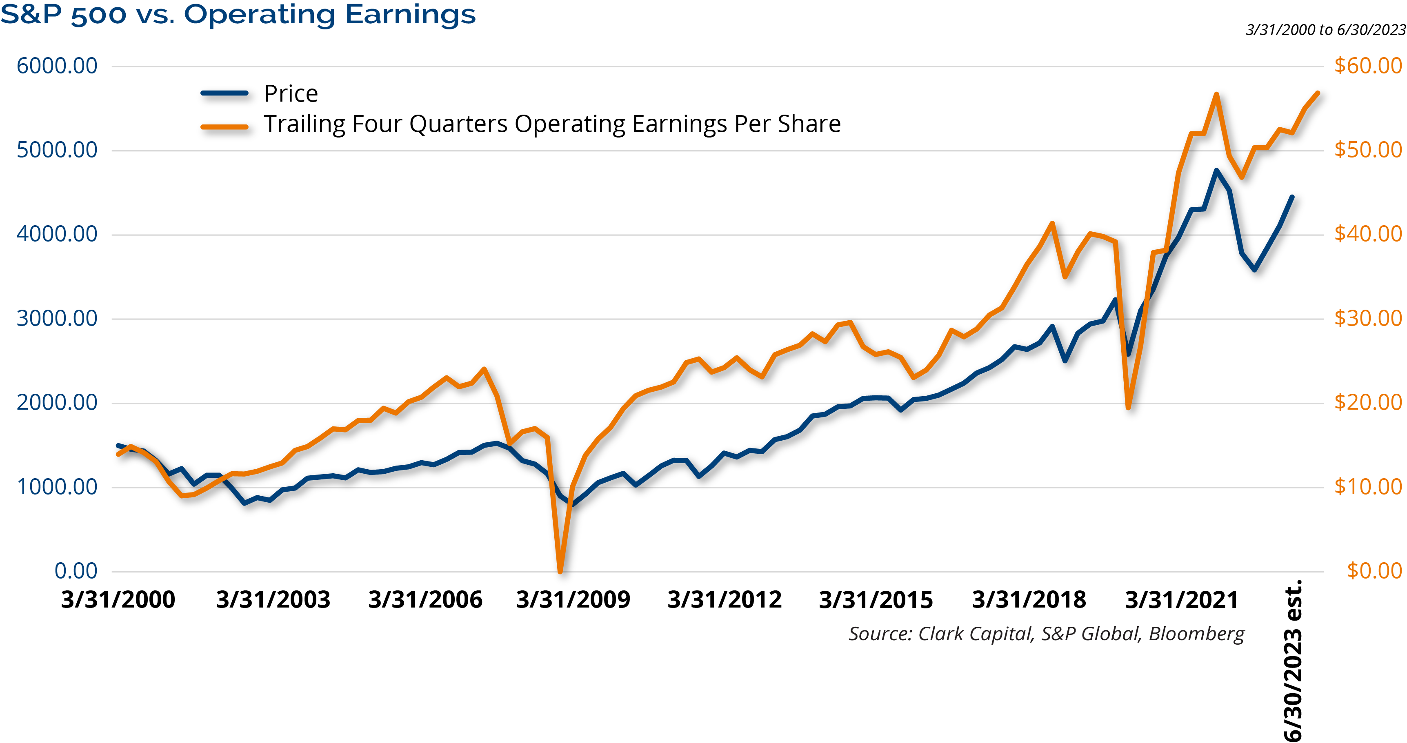
Earnings Drive Stock Prices
For illustrative purposes only. Neither past actual, projections, nor other forward looking statements regarding future financial performance of markets are only predictions and actual events or results may differ materially.
Notes:
We look at a lot of data and indicators to gauge the health of the economy. I’d like to share with you several that we put more stock in when assessing the economic outlook. Those are the Conference Board’s Index of Leading Economic Indicators, Housing Starts, the health of the labor market, and the shape of the yield curve. We’ve highlighted all three of those in each of the past several Market Outlooks. Up to this point their message has been continued economic growth.
The Conference Board’s Index of Leading Economic Indicators (the blue line on the bottom of this chart) has softened a bit but does not appear to be signaling a recession yet. This is important because it will typically turn down significantly on average 11 months before a recession. The red line on this chart is the Coincident Economic Index which measure how conditions are currently. Prior to a recession the Leading Index will typically cross below the Coincident Index and this has not happened

Slide 9
Why Did We Keep the Monetary Gauge Slow Negative?
The Fed finally skipped a meeting!
Market expectations more in line with Fed guidance
Fed back on QT path after regional bank scare
Fed done or close to it
Why does this matter? Fed tightening is a headwind for stocks
Notes:
We believe the Long Term Secular Bull Market is still alive. We are looking for about 8% price appreciation for the S&P 500. Earnings growing 8%, no P/E expansion. We expect more volatility this year, especially leading up to the elections. We do not see a recession on the horizon (through this year) although there have been some signs of slowing. Always lots of risks. International stocks could outperform US as valuations are attractive and will benefit if the dollar weakens. We think the Fed is on hold possibly through year end. Of course they are data dependent, but growth looks sustainable and inflation remains in check. We think interest rates are range bound between 1.5% to 2.5%.

Slide 10
Skip, Hike, Pause, Lower
For illustrative purposes only. Neither past actual, projections, nor other forward looking statements regarding future financial performance of markets are only predictions and actual events or results may differ materially.
Notes:
We look at a lot of data and indicators to gauge the health of the economy. I’d like to share with you several that we put more stock in when assessing the economic outlook. Those are the Conference Board’s Index of Leading Economic Indicators, Housing Starts, the health of the labor market, and the shape of the yield curve. We’ve highlighted all three of those in each of the past several Market Outlooks. Up to this point their message has been continued economic growth.
The Conference Board’s Index of Leading Economic Indicators (the blue line on the bottom of this chart) has softened a bit but does not appear to be signaling a recession yet. This is important because it will typically turn down significantly on average 11 months before a recession. The red line on this chart is the Coincident Economic Index which measure how conditions are currently. Prior to a recession the Leading Index will typically cross below the Coincident Index and this has not happened

Slide 11
What Has Historically Happened When the Fed is Done?
 |  | 3 Months After Last Hike |  |  | 6 Months After Last Hike |  |  | 12 Months After Last Hike |  |  | Last Hike to First Cut
Date of Last Hike | Date of 1st Cut | 3 Month Bill | Agg | S&P | 3 Month Bill | Agg | S&P | 3 Month Bill | Agg | S&P | 3 Month Bill | Agg | S&P
12/19/1989 | 7/13/1990 | 1.9% | -0.9% | -0.3% | 3.9% | 1.4% | 4.9% | 7.8% | 8.3% | -3.6% | 4.4% | 2.7% | 7.3%
2/1/1995 | 7/6/1995 | 1.4% | 4.8% | 9.5% | 2.8% | 9.3% | 18.8% | 5.6% | 16.9% | 35.2% | 2.4% | 10.5% | 17.8%
5/16/2000 | 1/3/2001 | 1.5% | 5.0% | 2.0% | 3.1% | 7.5% | -6.7% | 5.6% | 13.8% | -12.1% | 3.8% | 11.0% | -8.1%
6/29/2006 | 9/18/2007 | 1.2% | 4.1% | 4.9% | 2.5% | 5.4% | 11.4% | 5.0% | 6.5% | 18.1% | 6.0% | 9.6% | 19.4%
12/20/2018 | 8/1/2019 | 0.6% | 2.6% | 15.7% | 1.2% | 6.1% | 19.6% | 2.1% | 9.0% | 30.6% | 1.4% | 7.5% | 19.9%
 | Average | 1.3% | 3.1% | 6.4% | 2.7% | 6.0% | 9.6% | 5.2% | 10.9% | 13.6% | 3.6% | 8.3% | 11.2%
For illustrative purposes only. Past performance is not indicative of future results.
Source: FactSet, Clark Capital
Notes:
We look at a lot of data and indicators to gauge the health of the economy. I’d like to share with you several that we put more stock in when assessing the economic outlook. Those are the Conference Board’s Index of Leading Economic Indicators, Housing Starts, the health of the labor market, and the shape of the yield curve. We’ve highlighted all three of those in each of the past several Market Outlooks. Up to this point their message has been continued economic growth.
The Conference Board’s Index of Leading Economic Indicators (the blue line on the bottom of this chart) has softened a bit but does not appear to be signaling a recession yet. This is important because it will typically turn down significantly on average 11 months before a recession. The red line on this chart is the Coincident Economic Index which measure how conditions are currently. Prior to a recession the Leading Index will typically cross below the Coincident Index and this has not happened

Slide 12
Why Did We Keep Valuation Gauge Neutral?
Forward P/Es near long-term averages
Mid/Small cheaper than large; International cheaper than US
Downward earnings estimate revisions have slowed/ended
Why does this matter? We believe stocks still have appreciation potential
Notes:
We believe the Long Term Secular Bull Market is still alive. We are looking for about 8% price appreciation for the S&P 500. Earnings growing 8%, no P/E expansion. We expect more volatility this year, especially leading up to the elections. We do not see a recession on the horizon (through this year) although there have been some signs of slowing. Always lots of risks. International stocks could outperform US as valuations are attractive and will benefit if the dollar weakens. We think the Fed is on hold possibly through year end. Of course they are data dependent, but growth looks sustainable and inflation remains in check. We think interest rates are range bound between 1.5% to 2.5%.

Slide 13
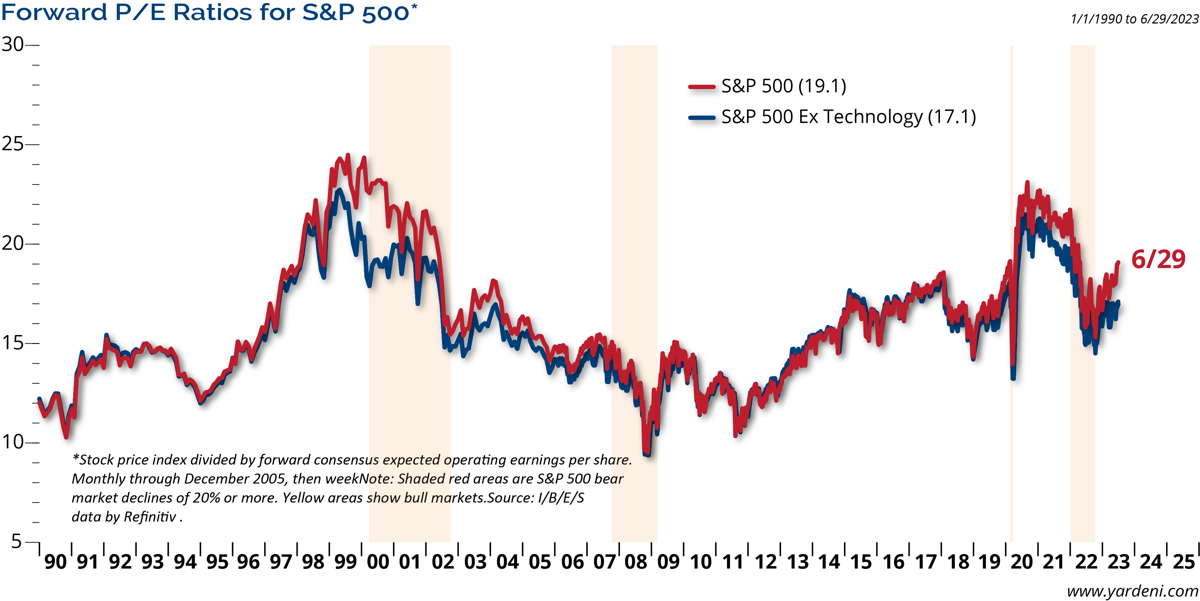
Tech Pushing Market Multiple Higher
For illustrative purposes only. Past performance is not indicative of future results.
Notes:
We look at a lot of data and indicators to gauge the health of the economy. I’d like to share with you several that we put more stock in when assessing the economic outlook. Those are the Conference Board’s Index of Leading Economic Indicators, Housing Starts, the health of the labor market, and the shape of the yield curve. We’ve highlighted all three of those in each of the past several Market Outlooks. Up to this point their message has been continued economic growth.
The Conference Board’s Index of Leading Economic Indicators (the blue line on the bottom of this chart) has softened a bit but does not appear to be signaling a recession yet. This is important because it will typically turn down significantly on average 11 months before a recession. The red line on this chart is the Coincident Economic Index which measure how conditions are currently. Prior to a recession the Leading Index will typically cross below the Coincident Index and this has not happened

Slide 14
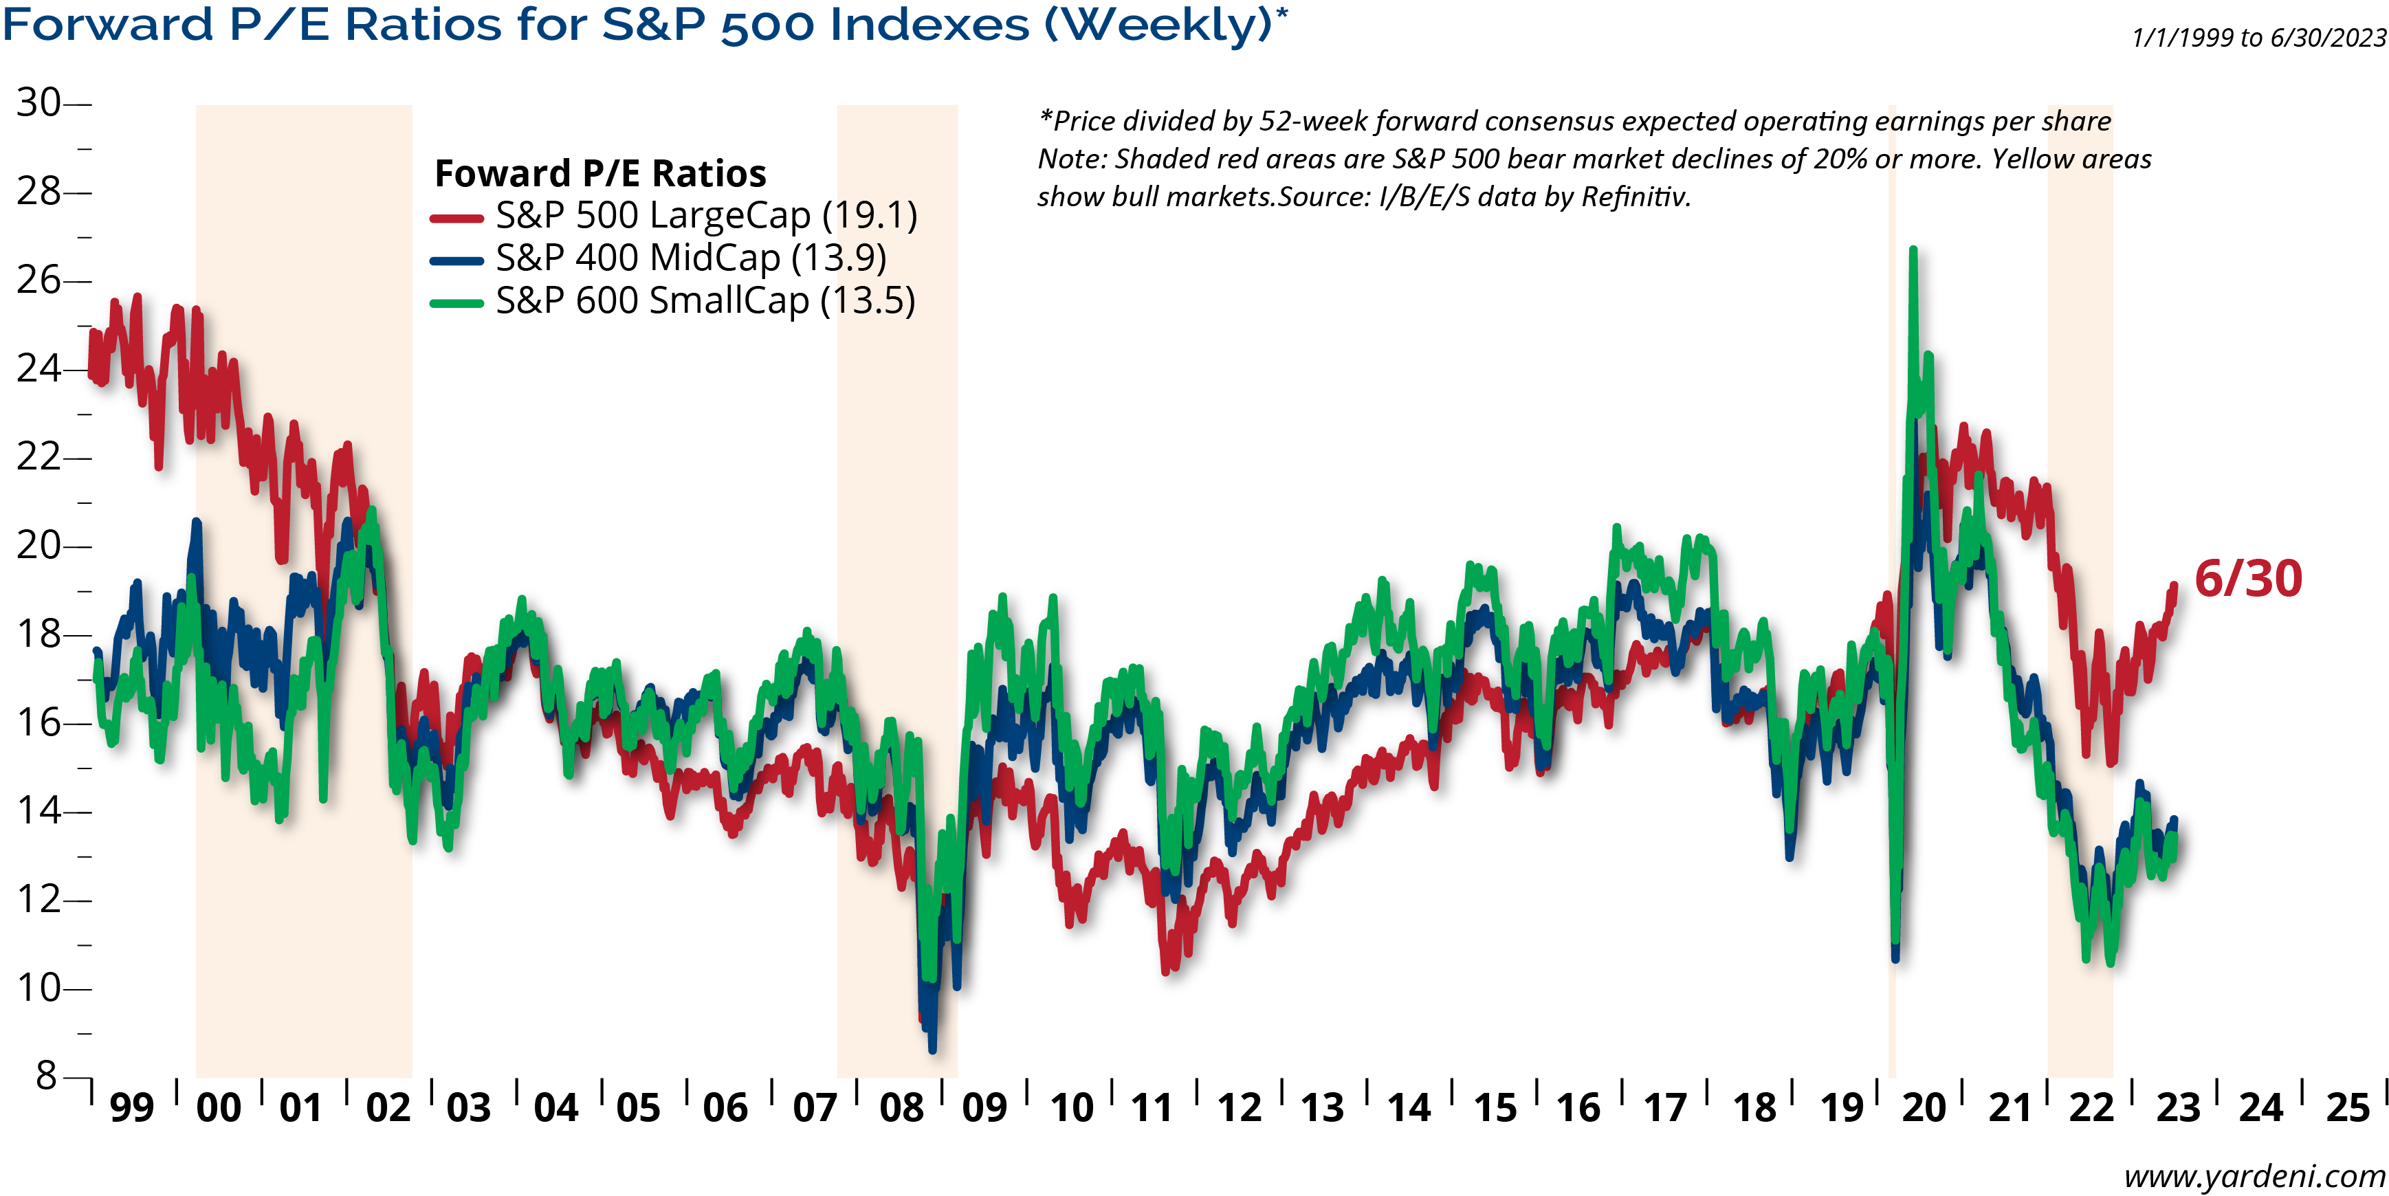
Mid & Small Look Cheaper
For illustrative purposes only. Past performance is not indicative of future results.
Notes:
We look at a lot of data and indicators to gauge the health of the economy. I’d like to share with you several that we put more stock in when assessing the economic outlook. Those are the Conference Board’s Index of Leading Economic Indicators, Housing Starts, the health of the labor market, and the shape of the yield curve. We’ve highlighted all three of those in each of the past several Market Outlooks. Up to this point their message has been continued economic growth.
The Conference Board’s Index of Leading Economic Indicators (the blue line on the bottom of this chart) has softened a bit but does not appear to be signaling a recession yet. This is important because it will typically turn down significantly on average 11 months before a recession. The red line on this chart is the Coincident Economic Index which measure how conditions are currently. Prior to a recession the Leading Index will typically cross below the Coincident Index and this has not happened

Slide 15
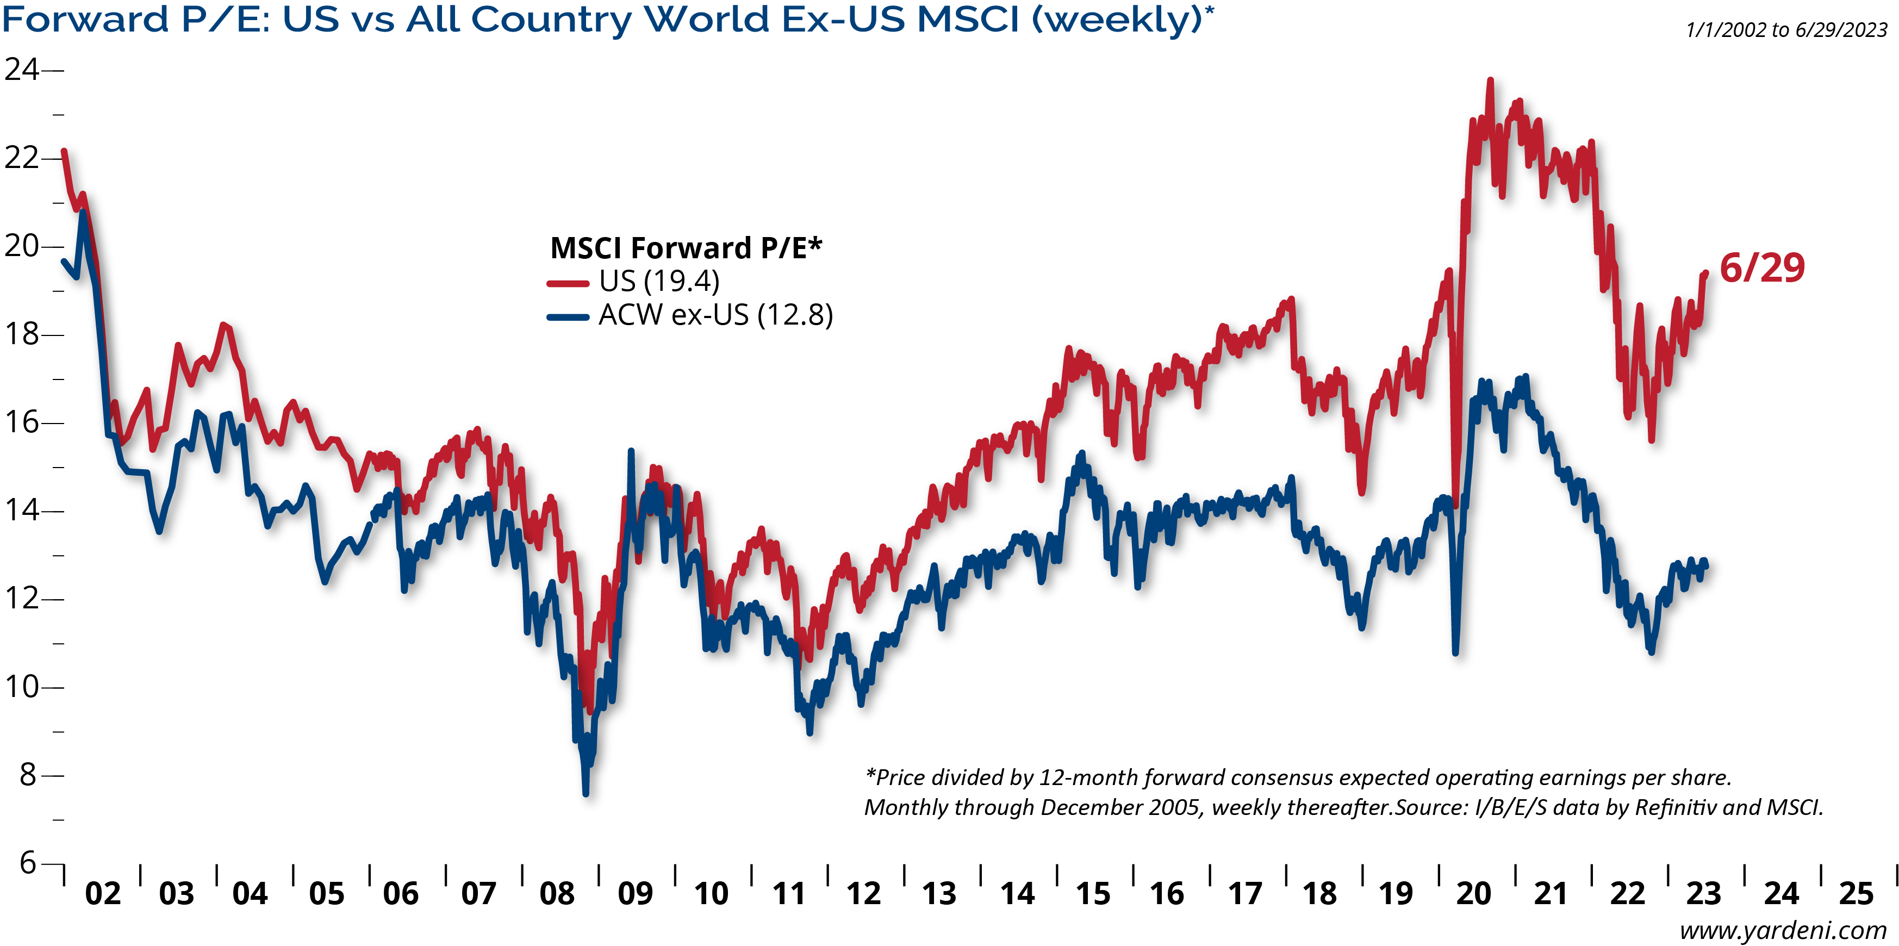
International Cheaper Than US
For For illustrative purposes only. Past performance is not indicative of future results.
Notes:
We look at a lot of data and indicators to gauge the health of the economy. I’d like to share with you several that we put more stock in when assessing the economic outlook. Those are the Conference Board’s Index of Leading Economic Indicators, Housing Starts, the health of the labor market, and the shape of the yield curve. We’ve highlighted all three of those in each of the past several Market Outlooks. Up to this point their message has been continued economic growth.
The Conference Board’s Index of Leading Economic Indicators (the blue line on the bottom of this chart) has softened a bit but does not appear to be signaling a recession yet. This is important because it will typically turn down significantly on average 11 months before a recession. The red line on this chart is the Coincident Economic Index which measure how conditions are currently. Prior to a recession the Leading Index will typically cross below the Coincident Index and this has not happened

Slide 16
Why Did We Move the Investor Sentiment Gauge backwards 2 Notches into Negative Territory?
Investors have become bullish! That’s not good!
Very sensitive gauge — can change quickly
Low volatility showing complacency
Why does this matter? Bottoms are formed when fear levels are high
Notes:
We believe the Long Term Secular Bull Market is still alive. We are looking for about 8% price appreciation for the S&P 500. Earnings growing 8%, no P/E expansion. We expect more volatility this year, especially leading up to the elections. We do not see a recession on the horizon (through this year) although there have been some signs of slowing. Always lots of risks. International stocks could outperform US as valuations are attractive and will benefit if the dollar weakens. We think the Fed is on hold possibly through year end. Of course they are data dependent, but growth looks sustainable and inflation remains in check. We think interest rates are range bound between 1.5% to 2.5%.

Slide 17
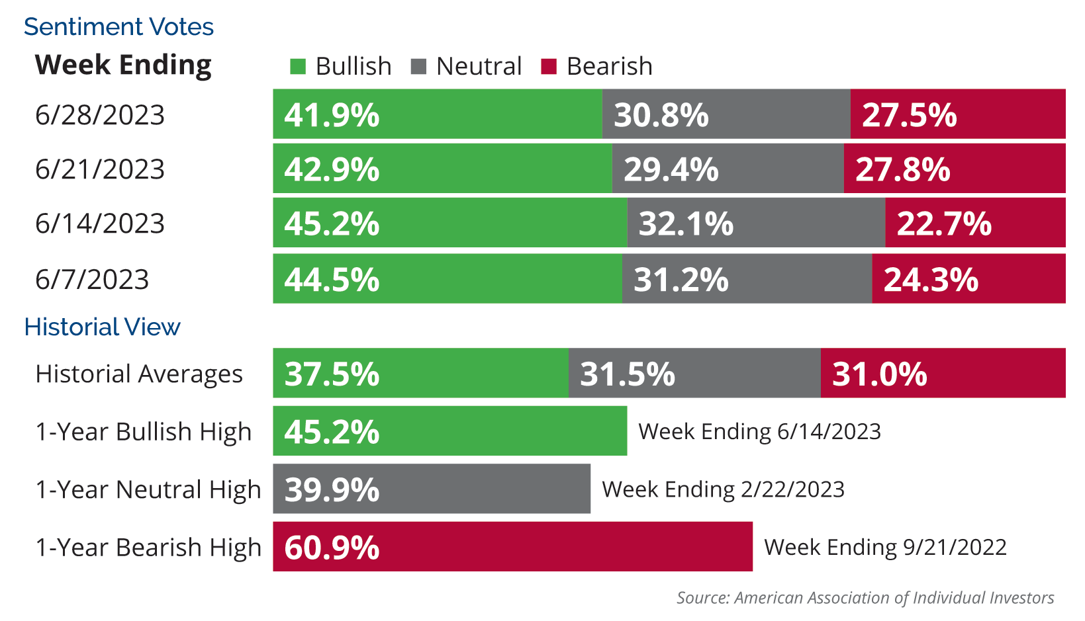
Bullishness Suggests a Headwind for the Market
For illustrative purposes only. Past performance is not indicative of future results.
Notes:
We look at a lot of data and indicators to gauge the health of the economy. I’d like to share with you several that we put more stock in when assessing the economic outlook. Those are the Conference Board’s Index of Leading Economic Indicators, Housing Starts, the health of the labor market, and the shape of the yield curve. We’ve highlighted all three of those in each of the past several Market Outlooks. Up to this point their message has been continued economic growth.
The Conference Board’s Index of Leading Economic Indicators (the blue line on the bottom of this chart) has softened a bit but does not appear to be signaling a recession yet. This is important because it will typically turn down significantly on average 11 months before a recession. The red line on this chart is the Coincident Economic Index which measure how conditions are currently. Prior to a recession the Leading Index will typically cross below the Coincident Index and this has not happened

Slide 18
Volatility Lower and Mostly Better
 | Days down 1% or More | Days up 1% or More | Total Days Greater than 1% Change
Q2 2023 | 3 | 9 | 12
2023 | 16 | 25 | 41
2022 | 63 | 58 | 121
2021 | 21 | 34 | 55
2020 | 45 | 64 | 109
For illustrative purposes only. Past performance is not indicative of future results.
Source: Bloomberg as of 6/30/23. S&P 500 Index, Clark Capital
Notes:
We look at a lot of data and indicators to gauge the health of the economy. I’d like to share with you several that we put more stock in when assessing the economic outlook. Those are the Conference Board’s Index of Leading Economic Indicators, Housing Starts, the health of the labor market, and the shape of the yield curve. We’ve highlighted all three of those in each of the past several Market Outlooks. Up to this point their message has been continued economic growth.
The Conference Board’s Index of Leading Economic Indicators (the blue line on the bottom of this chart) has softened a bit but does not appear to be signaling a recession yet. This is important because it will typically turn down significantly on average 11 months before a recession. The red line on this chart is the Coincident Economic Index which measure how conditions are currently. Prior to a recession the Leading Index will typically cross below the Coincident Index and this has not happened

Slide 19
Why Did We Keep the Interest Rate Gauge in Slow Negative?
Yield curve remains inverted
As expected, long-term rates have been declining
Why does this matter? Higher rates and flat/inverted yield curve have historically been a headwind for stocks
Notes:
We believe the Long Term Secular Bull Market is still alive. We are looking for about 8% price appreciation for the S&P 500. Earnings growing 8%, no P/E expansion. We expect more volatility this year, especially leading up to the elections. We do not see a recession on the horizon (through this year) although there have been some signs of slowing. Always lots of risks. International stocks could outperform US as valuations are attractive and will benefit if the dollar weakens. We think the Fed is on hold possibly through year end. Of course they are data dependent, but growth looks sustainable and inflation remains in check. We think interest rates are range bound between 1.5% to 2.5%.

Slide 20
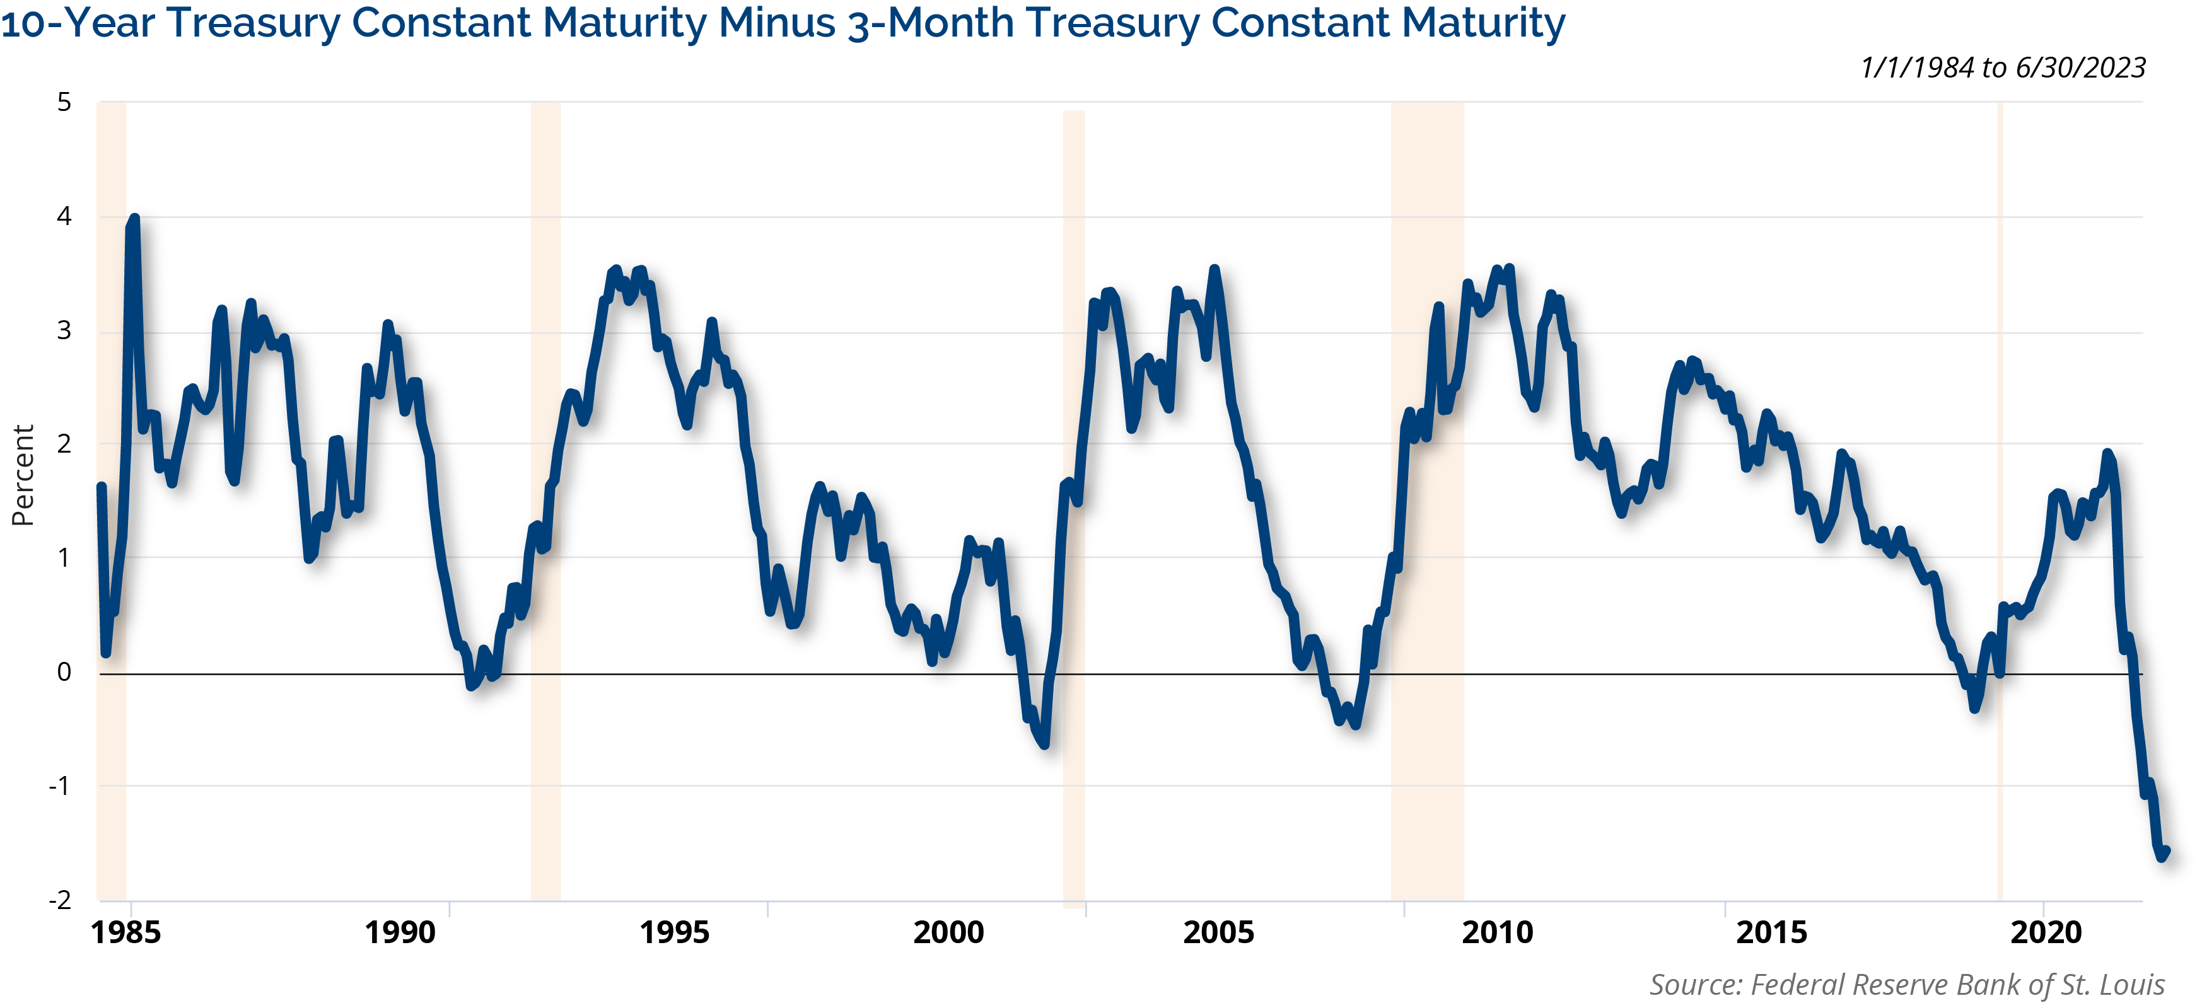
Inverted Yield Curve is a Concern
For illustrative purposes only. Past performance is not indicative of future results.
Notes:
We look at a lot of data and indicators to gauge the health of the economy. I’d like to share with you several that we put more stock in when assessing the economic outlook. Those are the Conference Board’s Index of Leading Economic Indicators, Housing Starts, the health of the labor market, and the shape of the yield curve. We’ve highlighted all three of those in each of the past several Market Outlooks. Up to this point their message has been continued economic growth.
The Conference Board’s Index of Leading Economic Indicators (the blue line on the bottom of this chart) has softened a bit but does not appear to be signaling a recession yet. This is important because it will typically turn down significantly on average 11 months before a recession. The red line on this chart is the Coincident Economic Index which measure how conditions are currently. Prior to a recession the Leading Index will typically cross below the Coincident Index and this has not happened

Slide 21
Q
&
A
Notes:
OK. Let’s get to some questions……
As we wrap up, please note that the replay of this webcast will be sent to you via email in the coming days and will also be available on our website ccmg.com.
Our Mid-Year Market Outlook will also be published as written commentary and that will be posted to our website as soon as it’s available. Thanks again for joining us—have a great rest of your day.
Again, thank you for joining today and for entrusting your client assets to us to manage. We look forward to stewarding those assets, and to helping clients stay on track to reach their long-term goals.

Slide 22
Disclosure
The opinions referenced are as of the date of publication and are subject to change due to changes in the market or economic conditions and may not necessarily come to pass. There is no guarantee of the future performance of any Clark Capital investment portfolio. Material presented has been derived from sources considered to be reliable, but the accuracy and completeness cannot be guaranteed. Nothing herein should be construed as a solicitation, recommendation or an offer to buy, sell or hold any sectors or securities, other investments or to adopt any investment strategy or strategies. For educational use only. This information is not intended to serve as investment advice. This material is not intended to be relied upon as a forecast or research. The investment or strategy discussed may not be suitable for all investors. Investors must make their own decisions based on their specific investment objectives and financial circumstances. Past performance does not guarantee future results.
This document may contain certain information that constitutes forward-looking statements which can be identified by the use of forward-looking terminology such as "may," "expect," "will," "hope," "forecast," "intend," "target," "believe," and/or comparable terminology (or the negative thereof). No assurance, representation, or warranty is made by any person that any of Clark Capital's assumptions, expectations, objectives, and/or goals will be achieved. Nothing contained in this document may be relied upon as a guarantee, promise, assurance, or representation as to the future.
Investing involves risk, including loss of principal.
Equity securities are subject to price fluctuation and possible loss of principal. Stock markets tend to move in cycles, with periods of rising prices and periods of falling prices. Certain investment strategies tend to increase the total risk of an investment (relative to the broader market). Strategies that concentrate their investments in limited sectors are more vulnerable to adverse market, economic, regulatory, political, or other developments affecting those sectors.
Fixed incomes securities are subject to certain risks including, but not limited to: interest rate (changes in interest rates may cause a decline in market value or an investment), credit, prepayment, call (some bonds allow the issuer to call a bond for redemption before it matures), extension (principal repayments may not occur as quickly as anticipated, causing the expected maturity of a security to increase), and inflation risk (rising prices will lower the purchasing power of the investment at maturity).
Non-investment-grade debt securities (high-yield/junk bonds) may be subject to greater market fluctuations, risk of default or loss of income and principal than higher-rated securities.
The economic gauges reflect the degree of Clark Capital’s positive (forward) or negative (reverse) outlook on the corresponding economic factors. The gauges represent the firm's expectations for the market, and how changes in the market will affect the strategy but are only projections which assume certain economic conditions and industry developments and are subject to change without notice.
CFA® and Chartered Financial Analyst® are registered trademarks owned by CFA Institute.
CAIA® is a registered trademark of the CAIA association.
Clark Capital Management Group, Inc. is an investment adviser registered with the U.S. Securities and Exchange Commission. Registration does not imply a certain level of skill or training. More information about Clark Capital’s advisory services can be found in its Form ADV which is available upon request.
CCM-648

Slide 23
Benchmark Descriptions
The S&P 500 measures the performance of the 500 leading companies in leading industries of the U.S. economy, capturing 80% of U.S. equities.
References to market or composite indices, benchmarks or other measures of relative market performance over a specified period of time (each, an “index”) are provided for your information only. Reference to an index does not imply that the portfolio will achieve returns, volatility or other results similar to that index. The composition of the index may not reflect the manner in which a portfolio is constructed in relation to expected or achieved returns, portfolio guidelines, restrictions, sectors, correlations, concentrations, volatility or tracking error targets, all of which are subject to change. Investors cannot invest directly in an index.
The MSCI ACWI ex USA Index captures large and mid cap representation across 22 of 23 Developed Markets countries, excluding the US, and 26 Emerging Markets countries covering approximately 85% of the global equity opportunity set outside the US.
The Composite Index of Leading Indicators, otherwise known as the Leading Economic Index (LEI), is an index published monthly by The Conference Board. It is used to predict the direction of global economic movements in future months. It is used to predict the direction of global economic movements in future months. The index is composed of 10 economic components whose changes tend to precede changes in the overall economy.
The Personal Consumption Expenditures Price Index (PCE) is a measure of the prices that people living in the United States, or those buying on their behalf, pay for goods and services. The PCE price index is known for capturing inflation (or deflation) across a wide range of consumer expenses and reflecting changes in consumer behavior.
Gross domestic product (GDP) is the monetary value of all finished goods and services made within a country during a specific period. GDP provides an economic snapshot of a country, used to estimate the size of an economy and growth rate.
Index returns include the reinvestment of income and dividends. The returns for these unmanaged indexes do not include any transaction costs, management fees or other costs. It is not possible to make an investment directly in any index.
The volatility (beta) of an account may be greater or less than its respective benchmark.
The 10 year treasury yield is included on the longer end of the yield curve. Many analysts will use the 10 year yield as the “risk free” rate when valuing the markets or an individual security. GDPNow is a forecasting model that provides a "nowcast" of the official GDP estimate prior to its release by estimating GDP growth using a methodology similar to the one used by the U.S. Bureau of Economic Analysis.
VIX of VIX (or VVIX) is a measure of the volatility of the Chicago Board Options Exchange (CBOE) Volatility Index (VIX). The CBOE's VIX measures the short-term volatility of the S&P 500 indexes, and the VVIX measures the volatility of the price of the VIX. In other words, VVIX is a measure of the volatility of the S&P 500 index and alludes to how quickly market sentiment changes.
The Producer Price Index (PPI) program measures the average change over time in the selling prices received by domestic producers for their output. The prices included in the PPI are from the first commercial transaction for many products and some services.
The nonfarm payroll measures the number of workers in the U.S. except those in farming, private households, proprietors, non-profit employees, and active military.
The price-to-earnings ratio is the ratio for valuing a company that measures its current share price relative to its earnings per share (EPS).
The S&P SmallCap 600 measures the small cap segment of the U.S. equity market. The index is designed to be an investable portfolio of companies that meet specific inclusion criteria to ensure that they are liquid and financially viable.
The benchmark is the S&P MidCap 400 Index. The S&P MidCap 400 provides investors with a benchmark for mid-sized companies. The index covers over 7% of the U.S. equity market, and seeks to remain an accurate measure of mid-sized companies, reflecting the risk and return characteristics of the broader mid-cap universe on an on-going basis.
The MSCI USA Index is designed to measure the performance of the large and mid cap segments of the US market. With 638 constituents, the index covers approximately 85% of the free float-adjusted market capitalization in the US.
The Core Consumer Price Index (CPI) measures the changes in the price of goods and services, excluding food and energy.
The S&P 500® Ex-Information Technology is designed to measure the broad U.S. market, excluding members of the GICS® Information Technology sector.
The 3 month Treasury yield is the effective annual interest rate paid by the U.S. government to a bondholder with a maturity of 3 months.

